Slide 1
VX 420: Business Basics for Entrepreneurship
The Lean LaunchPad: Partners
Version 6/15/12

Slide 2
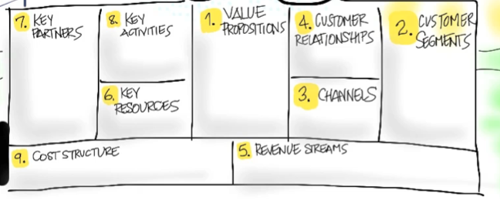
Key Partners
Who are your Partners and Suppliers?

Slide 3
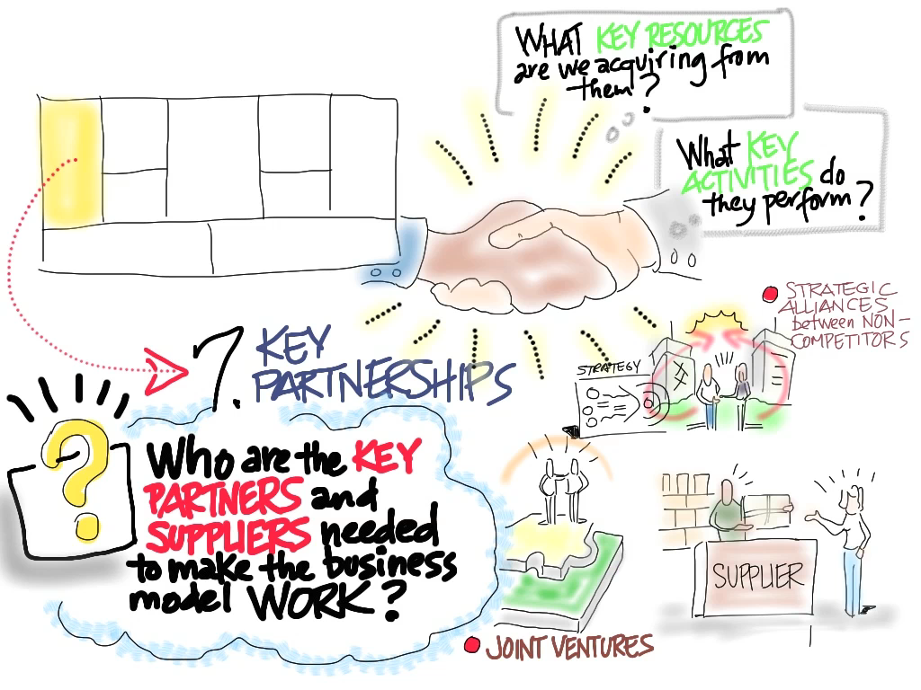
© 2012 Steve Blank

Slide 4
What defines a “Partner?”
Shared economics
Mutual success / failure
Co-development/invention
Common customer
But remember - you’re a startup

Slide 5
Why Have Partners?
Faster time to market
Broader product offering
More efficient use of capital
Unique customer knowledge or expertise
Access to new markets
Notes:
(need to do this as a build…)

Slide 6
Types of Partners

Slide 7



Partners – Strategic Alliances
Reduce the list of things your startup needs to build or provide to offer a complete product or service.
Use partners to build the “whole product”
using 3rd parties to provide a customer with a complete solution
complement your core product with other products or services
Training, installation, service, etc
Example:
In 1996, Starbucks partnered with Pepsico to bottle, distribute and sell the popular coffee-based drink, Frappacino

Slide 8

Partners – Joint Business Development
Joint promotion of complementary products
Share advertising, marketing, and sales programs
One may be the dominant player
Example:
Intel offered advertising fees to PC Vendors

Slide 9
Startup mistake
Strategic alliances and joint partnerships
Not needed for Earlyvangelists
Are needed for Mainstream customers
Usually fail

Slide 10

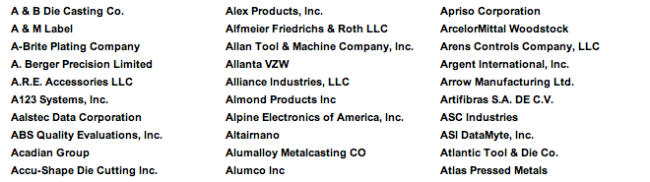
Partners – Coopetition
Joint promotion of competitive products
Competitors might join together in programs to grow awareness of their industry
Tradeshows
Industry Associations
Example:
Automotive Suppliers form the Automotive Industry Action Group (AIAG) - 900 members

Slide 11
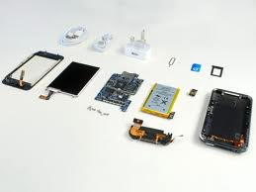
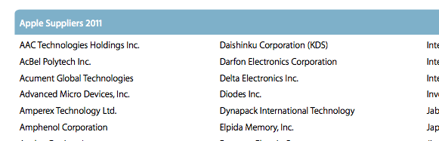
Partners – Key Suppliers
Outsource suppliers
Backoffice, supply chain, manufacturing
Direct suppliers
Components, raw materials, etc.
Example:
Apple builds the iPhone from multiple suppliers

Slide 12
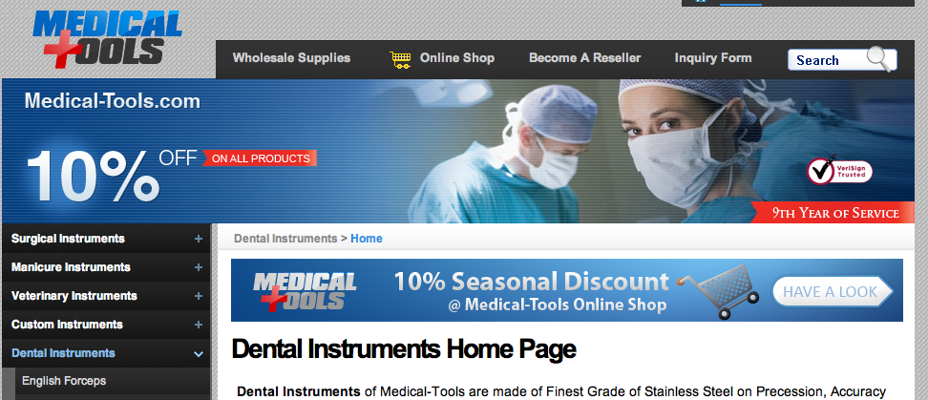
Traffic Partners – Virtual Channels
Long-term agreements with other companies
deliver long-term, predictable levels of customers
“Cross referral” or swapping basis
Paid on a per-referral basis
Partners drive traffic using text-links, with onsite promotions, and with ads on the referring site
Partners sometimes exchange email lists
http://medical-tools.com/dental/

Slide 13
Partner Risks

Slide 14
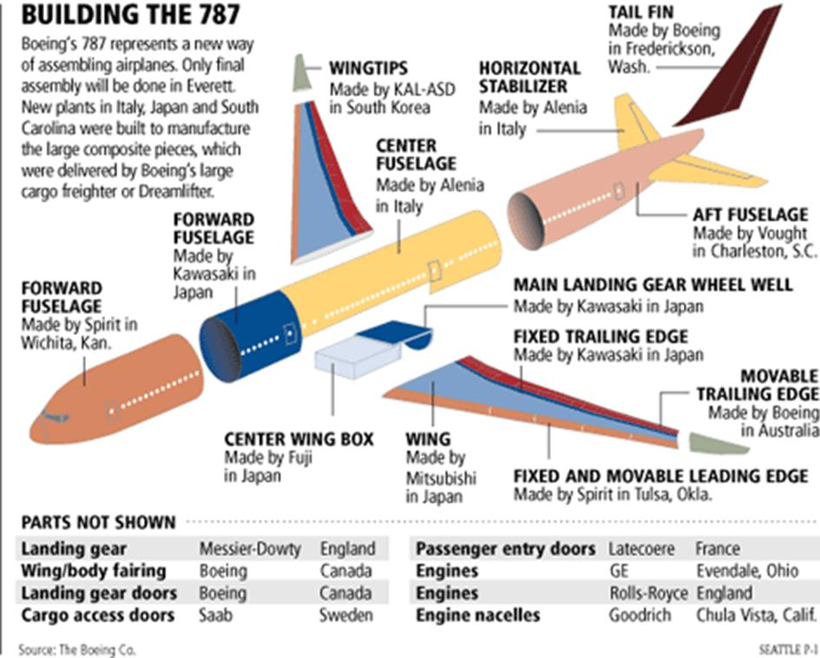
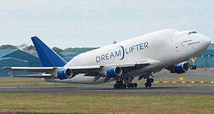
Partnership Disaster: Boeing
Collaborative
Looked great on paper.
Worst business decision of the 21st century

Slide 15
Managing partners - Risks
Impendence mismatch
Longest of partners schedule becomes your longest item
No clear ownership of customer
Products lack vision – shared product design
Different underlying objectives in relationship
Churn in partners strategy or personnel
IP issues
Difficult to unwind or end

Slide 16
Should I take an investment from a Large Company?
They are interested in their bottom line, not yours
Their objectives are not to make you a large company
Who’s the sponsor? What’s the motivation?
Needs to come from the business side
Not the venture side
Try to get sales deals not investment
Or try to offer warrants based on sales success

Slide 17
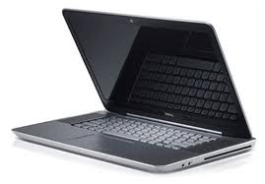

Startup Partner Strategies
Don’t confuse partners for Earlyvangelists vs. mainstream
Don’t confuse big company partnering with startup strategy
Find the one that gives you an unfair advantage
Recognize you don’t matter to a large partner

Slide 18
Catalysts
Partner Examples

Slide 19








Partners: Hypothesis and Experiments
Thru-Pore
Technologies
Catalyst Companies
Contract Manufacturers
Distributors
Research Catalysts, Inc.
T3

Slide 20
Materials Coating
Partner Examples

Slide 21
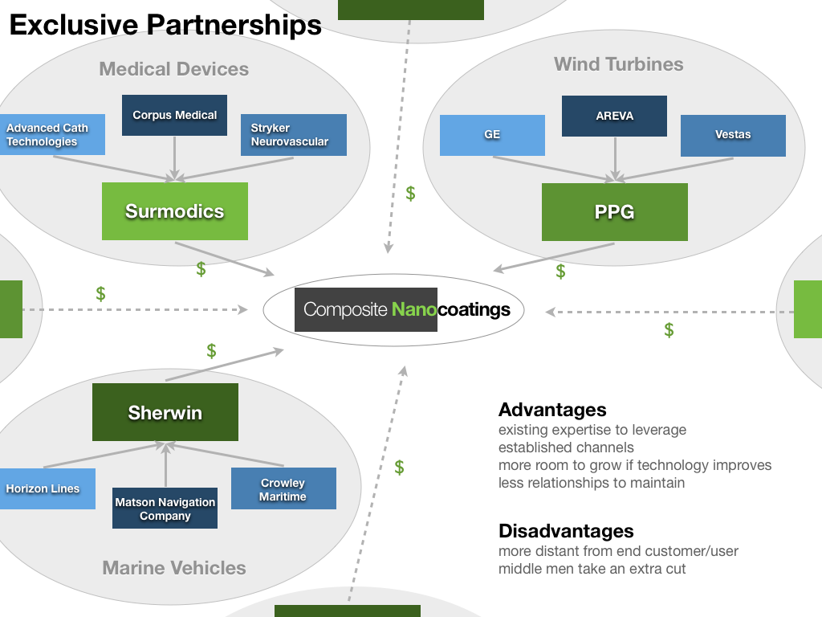

Slide 22
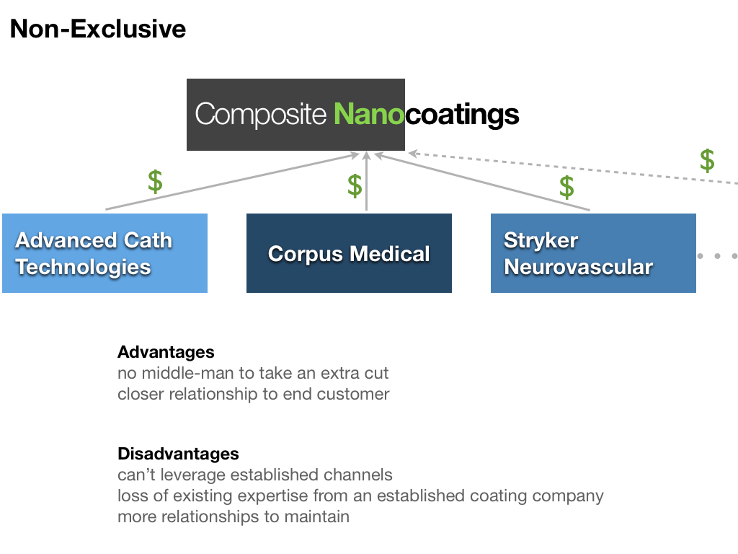

Slide 23
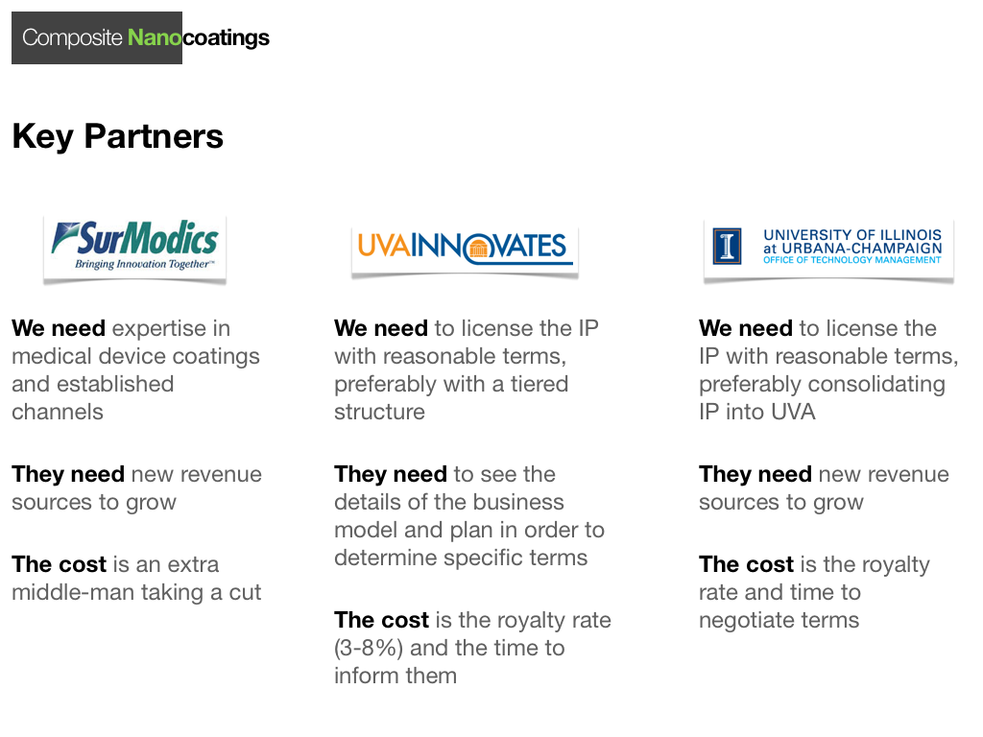

Slide 24
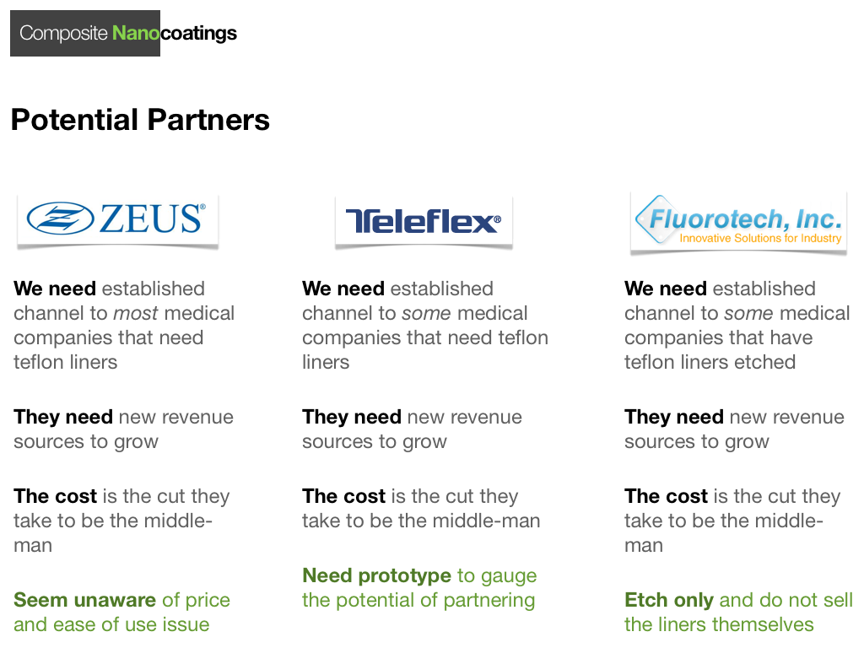

Slide 25
Molecular Diagnostics
Partner Examples

Slide 26
Partners
Back End
Front End
Sample Prep (not for RUO)
Dx Test Company
Hospitals
Chip Manufacturers
LiquiLume
Clinical Labs
Packaging
Reagents
(IDT, Fisher)
Doctors
Distributors (Fisher)
OEMs
Research Labs
Shippers (UPS, FedEx)

Slide 27
Back-End Partners
Type | Examples | Benefit | Risk / Need
Chip manufacturer | HTE Labs | Make optofluidic chips (key element of technology) | High / Critical
Packaging | ? | Keep device costs low | Low / Essential
OEMs | Laser or detector manufacturers | Parts needed to build complete instrument | Low, Med / Essential
Reagents Supplier | IDT, Fisher | Provide custom probes and control targets. | Med / Essential
Sample Prep. Instrument | Qiagen | Partner for validation of input target samples | Low / Nice

Slide 28
Front-End Partners
Type | Examples | Benefit | Risk / Need
Distributor | Fisher | Sell chips, reagents | Low / Not critical for RUO
Research labs | UCSF oncologists, Stanford MDx Lab, UCSF Micro. Lab | Will validate technology; publish; develop assays | Low / Critical during phase I
Dx test company | Genentech; Companion Dx w pharma and biotechs; Specialty Dx test cos. | Possibly unique test on unique platform, partner develops assay Strategic alliance | Low / Synergistic
Clinical labs | Quest, LabCorp | Help develop CLIA-waived application; 510(k); clinical trials | Med / Crucial during phase II

Slide 29
Complex Sensor Networks
Partner Examples

Slide 30






















Universe of Partners
Sensor device/network co’s
Embedded platform makers
SET
Application specialists

Slide 31

Potential Partnerships
Sensor device/network co’s
Embedded platform makers
SET
Application specialists

Slide 32
Medical Device
Partner Examples

Slide 33

MammOptics
Partnerships: Distribution
Value Proposition
CONFIRMED
Efficacy is easier to sell than safety
Good data convinces customers
Per use fee presents risk of competition
CONFIRMED
Pricing
Jed Hwang
Sales Representative
Cardiovascular industry
Lazik surgery as proxy
Per use fee opens up sales
Partnerships
Who are national and regional KOLs
Market research
$300/dr/hr
Min $50
15-20% acceptance
Outsourcing cost
Colleagues
Publishing
Important trials

Slide 34

MammOptics
Partnerships: Clinical Trials
Method to estimate number of patients based on desired efficacy
Key parameters: specificity and sensitivity
Overview of more accurate statistical analysis of interim studies
Need to hire professional statistician
Provide contacts for hiring appropriate statisticians
Noah Simon
Graduate Student
Statistics, Stanford

Slide 35

MammOptics
Partnerships: Reimbursements
“The reimbursement environment is complex, somewhat hazy, and can be hostile”
Codes
Coverage
Payment
Shannon Bergstedt
CardioDX
Reimbursement Office
Reimbursement officer
Startup
Insurance
Pays for procedure
Pays membership
Notifies of procedure
Doctor
Patient
Provides service

Slide 36

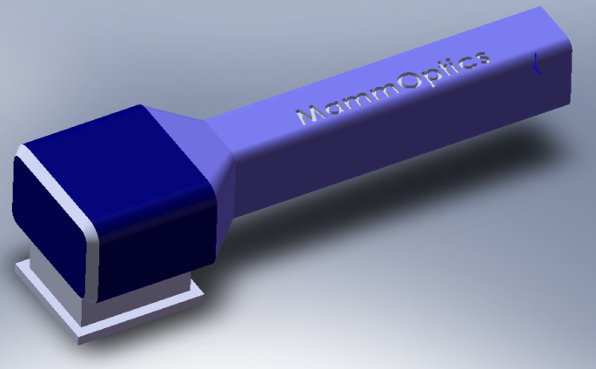

MammOptics
Partnerships: Manufacturing
Don Archambault, Director of Business Development, Omnica Corporation: specialized in MEDICAL DEVICE DESIGN, product engineering and product development.
9 Inches
DSP
RFIC
~5 lbs
Photo probe
Disposable head
Scanning Device, 75% Gross margin
- Initial Discounts to gain adoption
COGS
$4-5k per unit
COGS
$4-5k per unit
Gross Profit
Gross Profit
12-15k
per unit
Discounts for Initial Market

